Slide 1



The Effects of Forest Management Practices on Feedbacks between Plants and Soil Organisms
Northern Arizona University
Mildred Diaz
Anita Antoninka and Kara Gibson

Slide 2
The Current Problem
Catastrophic fires in the southwest occurring because of close proximity and heavy accumulation of fire fuels (litter) that can help spread a canopy fire
  EX: Las Conchas Fire
To help reduce the occurrence of these fires forest managers use thinning and burning treatments
https://wildfiretoday.com/tag/las-conchas-fire/

Slide 3
Purpose of the Study
Forests in the Southwest are commonly treated with thinning and controlled burns to help restore their health
Little work has looked at how these practices impact the soil biota
Our study will test the effects of thinning and burning on the abundance of EM and AM mycorrhizal fungi and soil microarthropods, as well as how these organisms interact to affect host plants.
Ectomycorrhizal (EM) Fungi
https://en.wikipedia.org/wiki/Ectomycorrhiza
Arbuscular mycorrhizal (AM) fungi
http://www.soilquality.org.au/factsheets/arbuscular-mycorrhizas-s-a
Microarthropods
http://svalbardinsects.net/index.php?id=18
Notes:
Mycorrhizae- symbionts plant feed fungi fixed carbon and in turn they give the plant limited nutrients
Microarthropods help disperse fungal propagules through fecal route

Slide 4
Goals and Predictions
Objective: Examine soil biota’s influence on plant productivity and mycorrhizal colonization.
AM plant host will have a higher colonization rate in soil from the restored plot compared to the control plot.
Microarthropods were expected to be less abundant in soil from restored plot
Mycorrhizal colonization will be reduced in defaunated treatments
https://kobi5.com/news/senator-deboer-offers-solutions-to-our-smoky-skies-60930/
https://www.wildlandnw.net/dry-forests-ii
Notes:
AM- more open canopy leading smaller plants to grow which are mostly AM host
Lose litter layer dominate food source

Slide 5
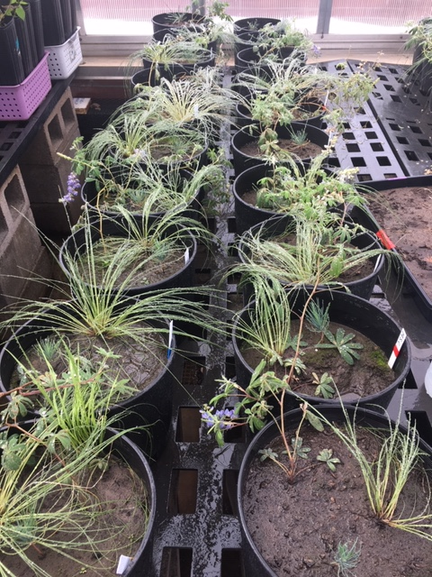
Our Investigation
60 mesocosms were set up with 3 host plants, Pinus ponderosa (EM host), Festuca arizonica (AM host), Lupinus argenteus (non-mycotrophic)
Control Plot
Thin/Burn Plot
Non-Mycotrophic
Sterile
EM
AM
Microarthropods
Defaunated
EM
AM
Live
EM
AM
Microarthropods
Sterile
EM
AM
Microarthropods
Defaunated
EM
AM
Live
EM
AM
Microarthropods
AM Host
EM Host
Notes:
The plants were given 5 months in the soil inoculum

Slide 6
Results
Total Shoot Biomass for All Plant Host

Slide 7
Results and Analysis
Root Biomass of F. arizonica for Soil Treatments
Root Biomass of L. argentus for Soil Treatments
Soil Treatment | Thin/Burn and Control Plots (TB/C) | Mean total FEAZ roots | Std Err FEAZ total roots
Sterile | C | 2.263281276 | 0.5459894229
Defaunated | C | 1.50400591 | 0.2012942644
Live | C | 1.426213 | 0.2177340392
Sterile | TB | 1.845289288 | 0.1796978566
Defaunated | TB | 4.945540482 | 3.251703382
Live | TB | 2.049129932 | 0.5555611669
Soil treatments had no significant effect on plant and root biomass
We expect to see more of an effect in root colonization
Notes:
Ponderosa pine no root biomass cause have to do mycorrhizal colonization first

Slide 8
Conclusions
More analyses are in progress
Plant were reared in an environment with little stress compared to their actual environment
  Had access to plenty of water
  Soil treatments could have resulted in release of nutrients
Further analyses will be done to quantify plant-available nutrients
Notes:
Our conclusion to date are positive from the perspective of a land manger …but there are some caveats:

Slide 9
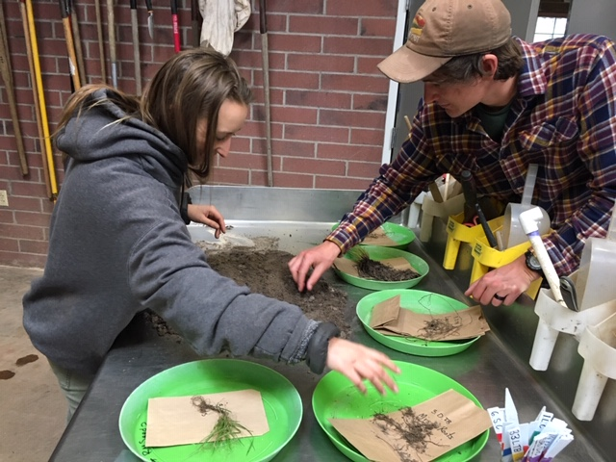
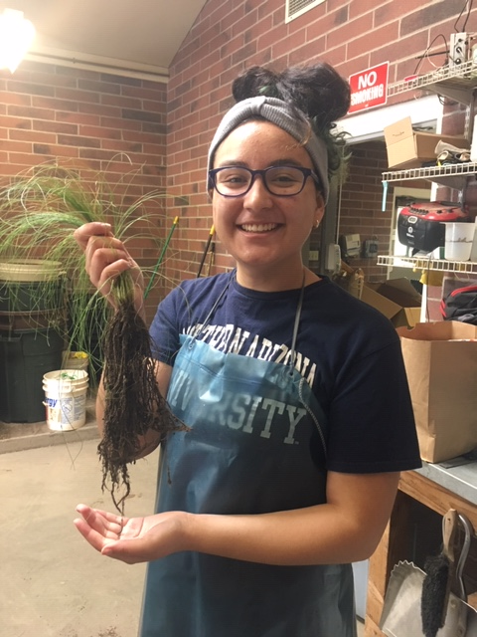
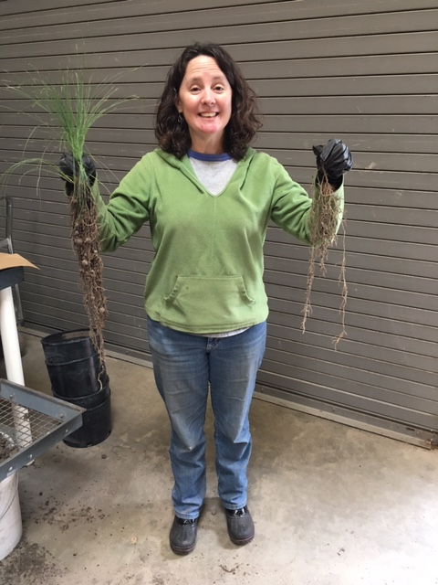
Acknowledgments
I would like to thank my mentors Anita Antoninka and Kara Gibson as well as our lab members for all their help on the project. The grants that helped fund this project were the Hooper Undergraduate Research Award.
ANY QUESTIONS?

